Slide 1
Software Metrics GROUP 1
Mondays’ presentation

Slide 2
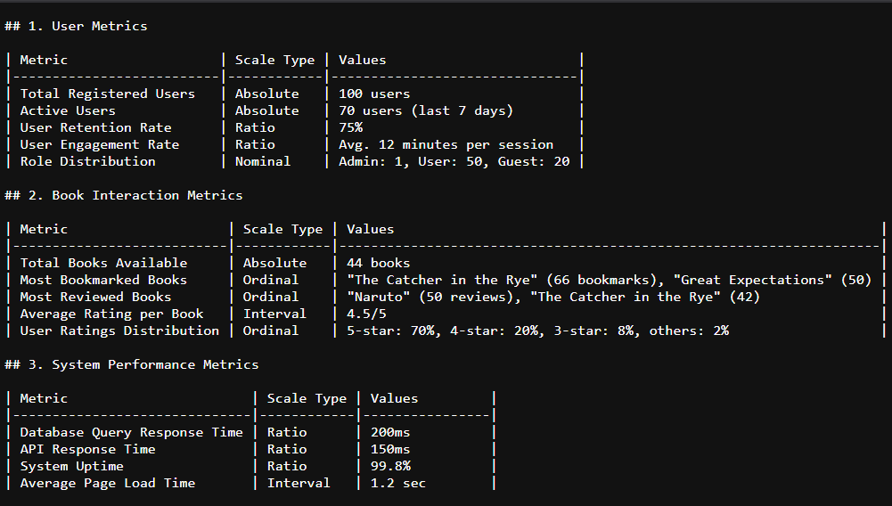

L2 Measurement Theory Implementation
Users can be one of these categories: guest, user and admin

Slide 3
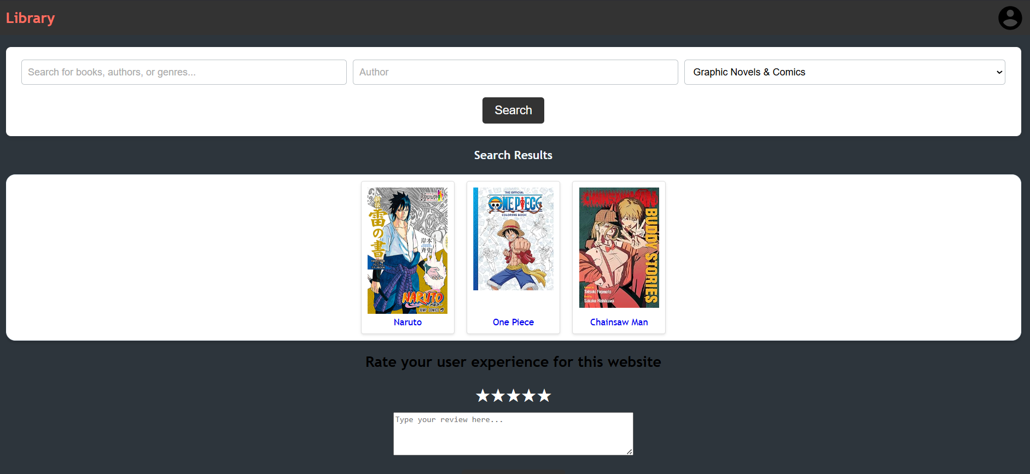

Slide 4
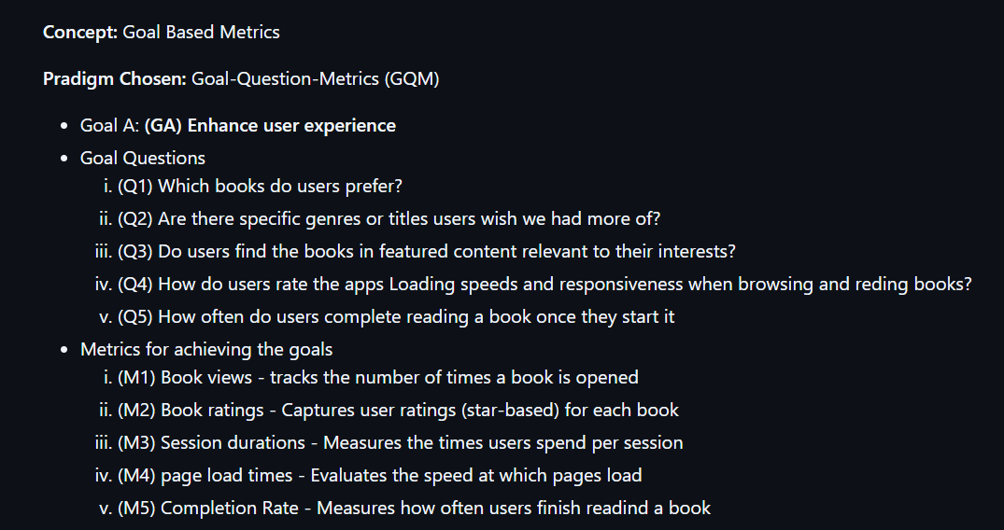
L3 Goal-based software measurement

Slide 5
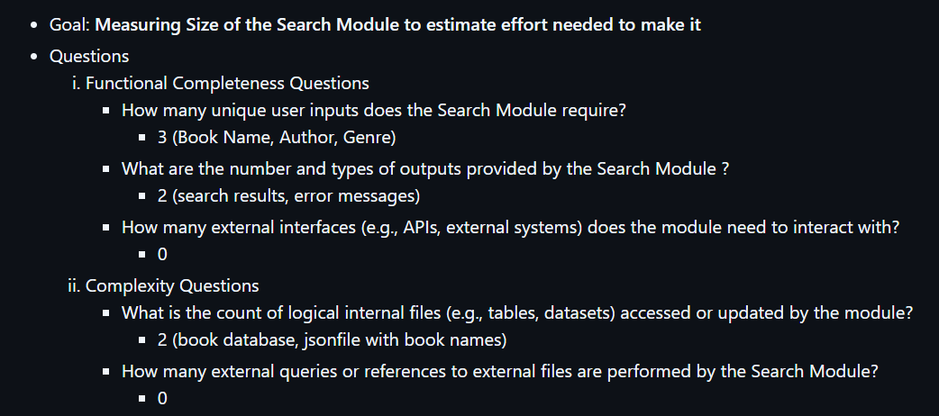
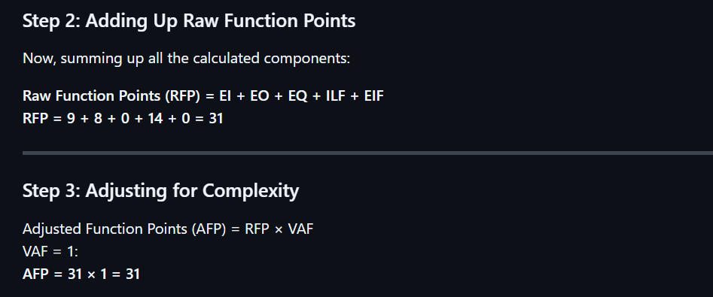
L4&L5 Empirical Investigation and Software size

Slide 6
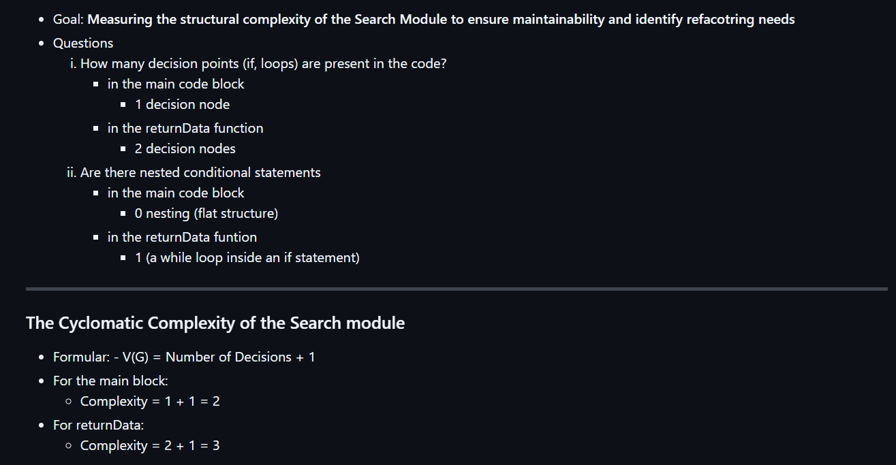
L6 Structural Complexity

Slide 7
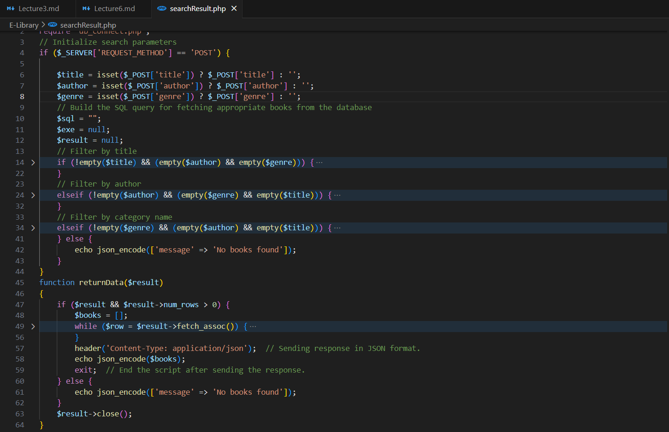

Slide 8

L7 Software Cost Metric

Slide 9
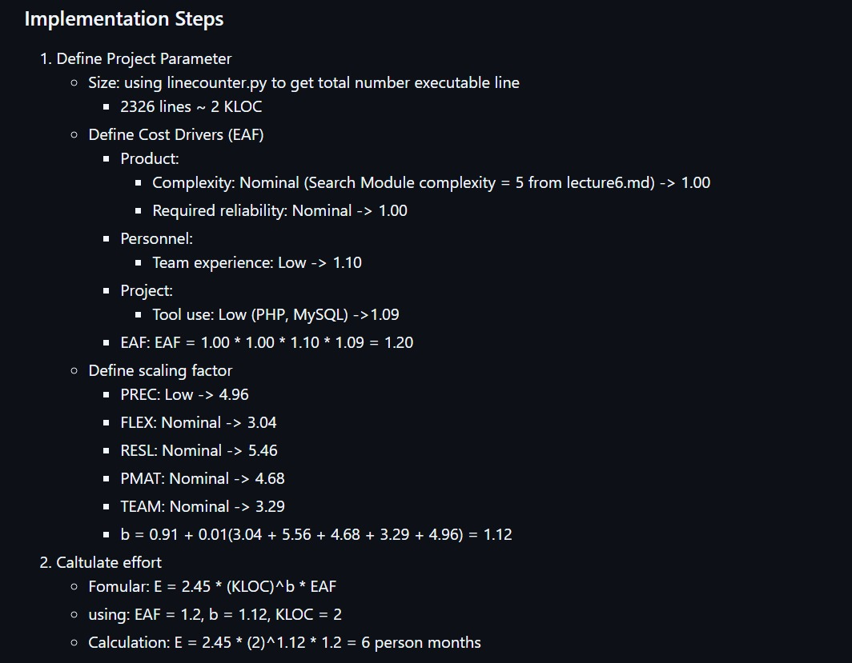

Slide 10
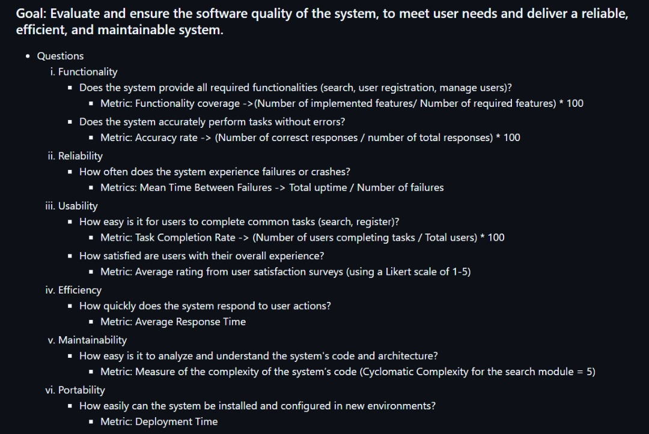
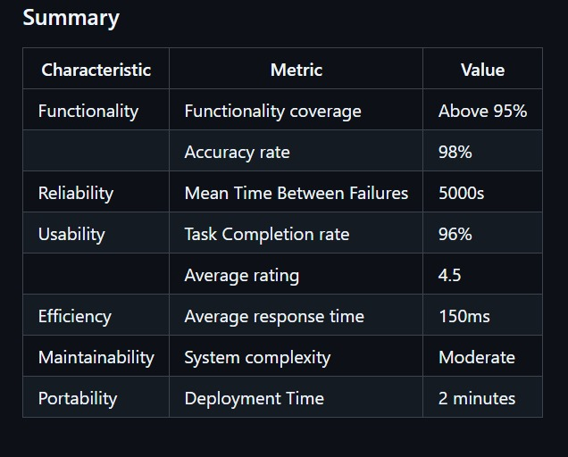
L8 Software Quality

Slide 11
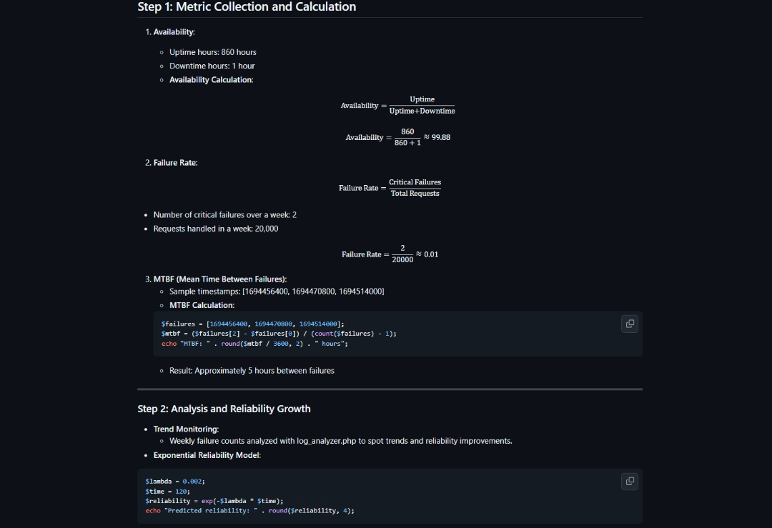
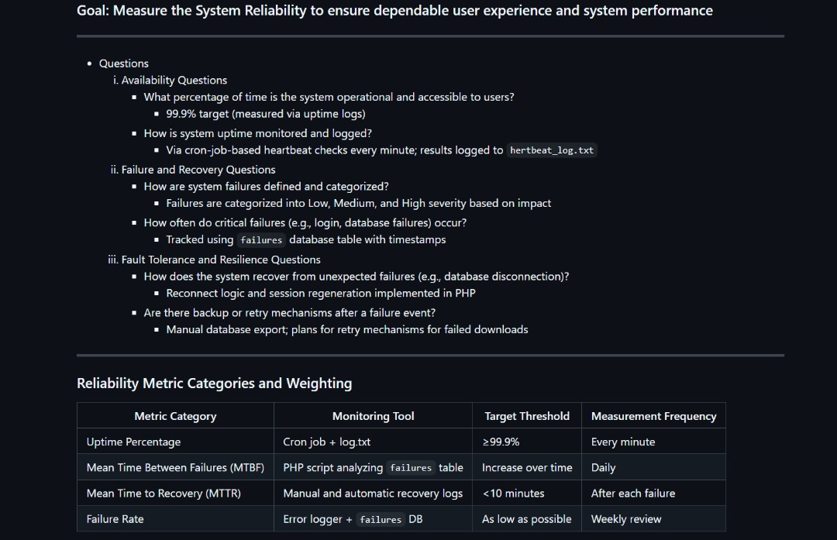
L9 Software Reliability Models and Metrics

Slide 12
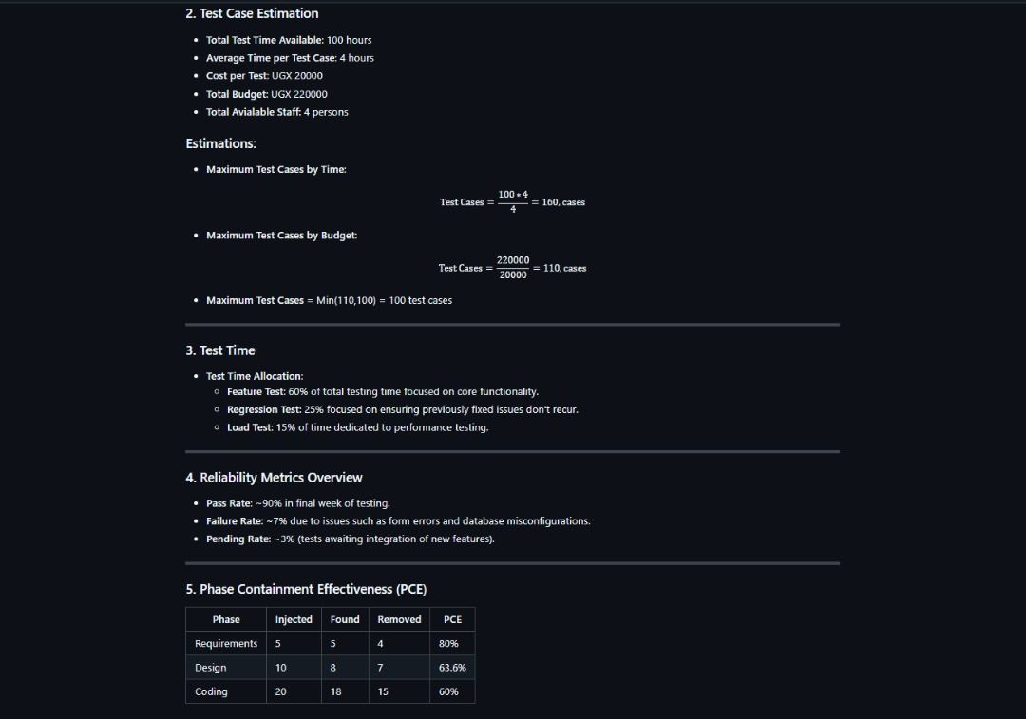
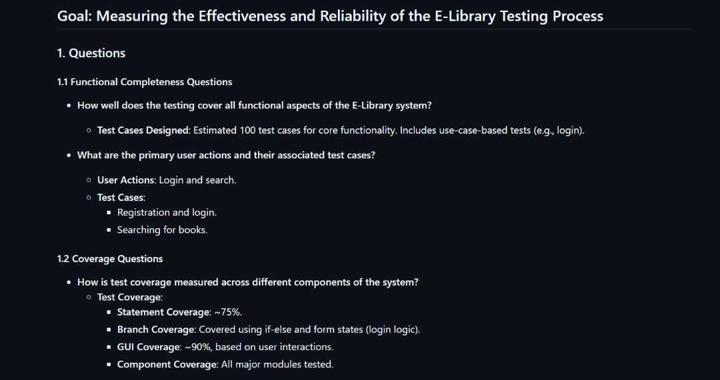
Software Test Metrics

Slide 13
Object Oriented Metrics

